Slide 1
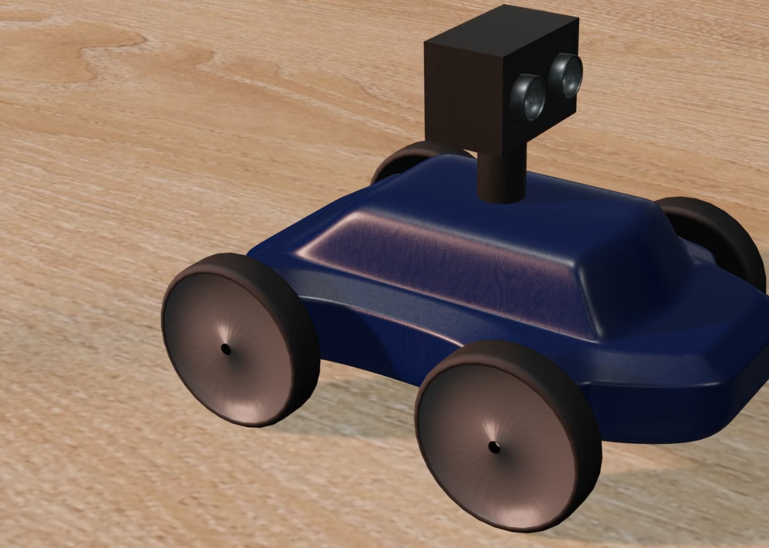
What have we created?
Robot that makes waking up in the morning more exciting and physically stimulating by escaping from you

Slide 2
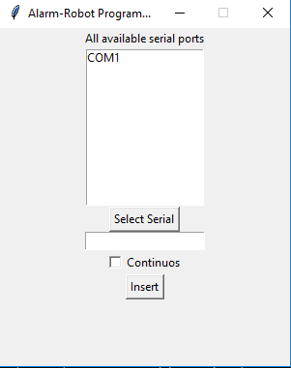
Functionality
Code is written around finite state machine
Simple GUI application for time input
Starts alarming after the time interval
After alarm the robot starts moving forward
If it encouters obstacles, it is evaded
Alarm can be stopped with shaking the machine for some time

Slide 3
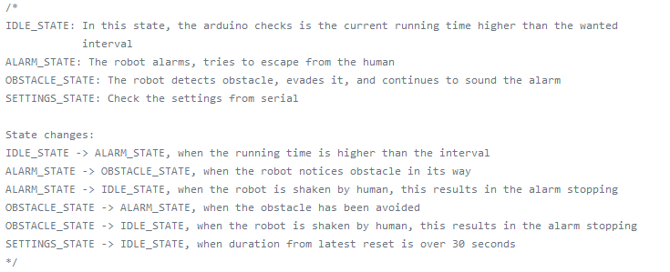

Slide 4
Example
This how the robot should function when it encounters an obstacle.

Slide 5
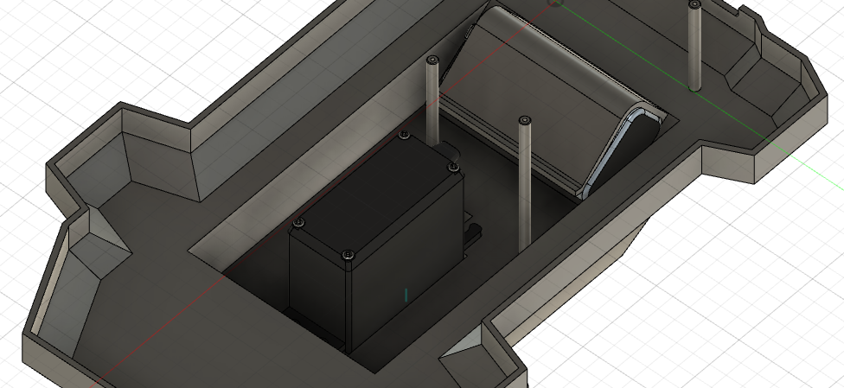
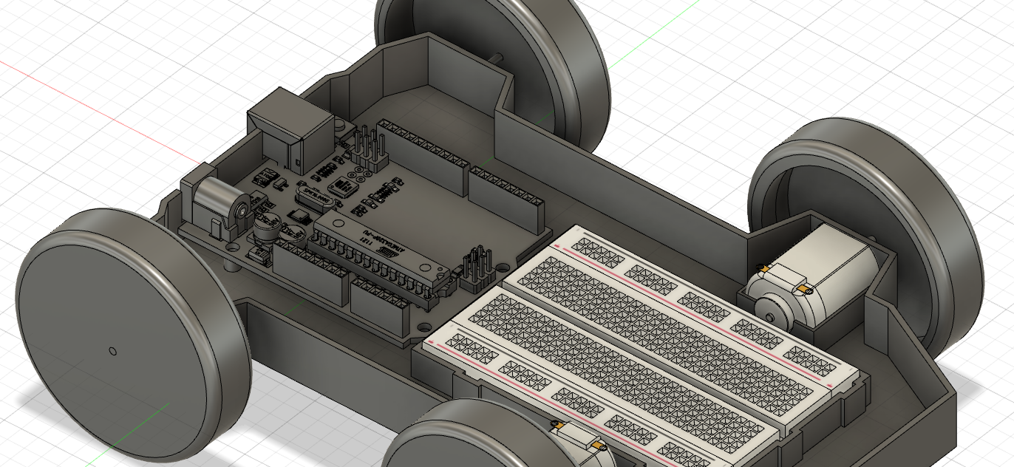
CAD
Features:
Mounts for all components
Posts for the arduino to sit on
Holes for arduino I/O
Screws shut on the bottom

Slide 6
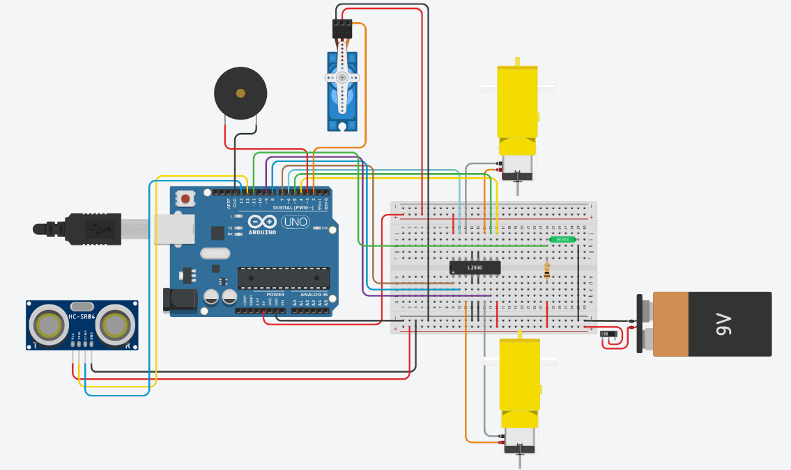
TinkerCad
Features:
H-bridge for changing DC direction
Battery with a power switch
Servo for turning the sonar sensor
Piezo buzzer for alarm
Tilt sensor

Slide 7
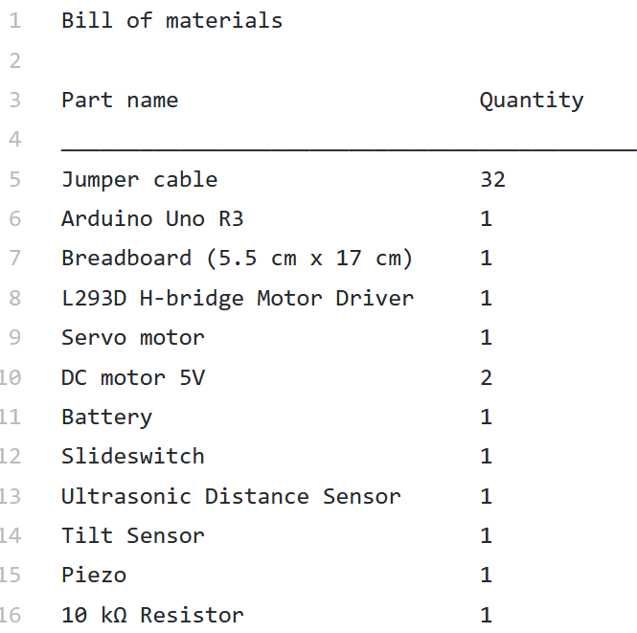
Bill of Materials

Slide 8
Improvements
There should be another way of inputting wanted time interval
It would be also good to show the time till the alarm on the robot with LCD-Screen
The bot could have some status LEDs to indicate current state

Slide 9
Thank you!
Github: https://github.com/illale/alarm-robot

